Slide 1


Welcome to
INTERNSHIP STUDIO
Module 05 | Lesson 06
Recurrent Neural Network (CNNs)
WWW.INTERNSHIPSTUDIO.COM

Slide 2

Sequence Problems
The output depends on
Current Input
Previous Output
Traditional neural network cannot capture such relationship
WWW.INTERNSHIPSTUDIO.COM

Slide 3
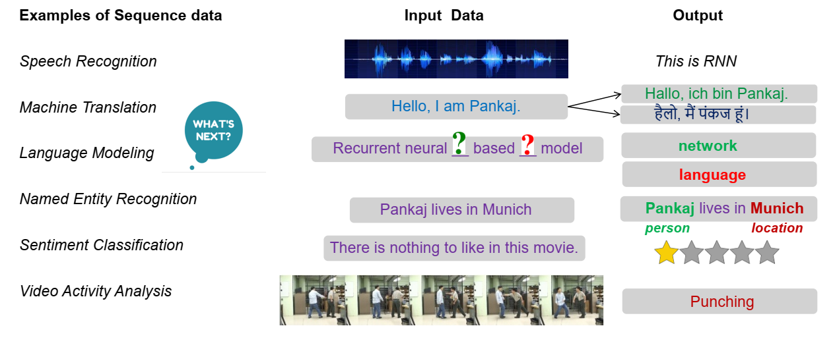
Need for sequential modelling
WWW.INTERNSHIPSTUDIO.COM

Slide 4

Recurrent neural networks
MLPs and CNNs expect fixed-sized input, not sequences
RNNs have memory and recurrent connections, i.e. loops
last output contains a representation of the whole sequence
learning by backpropagation through time
vanishing or exploding gradients!
WWW.INTERNSHIPSTUDIO.COM

Slide 5

Recurrent neural networks
WWW.INTERNSHIPSTUDIO.COM

Slide 6
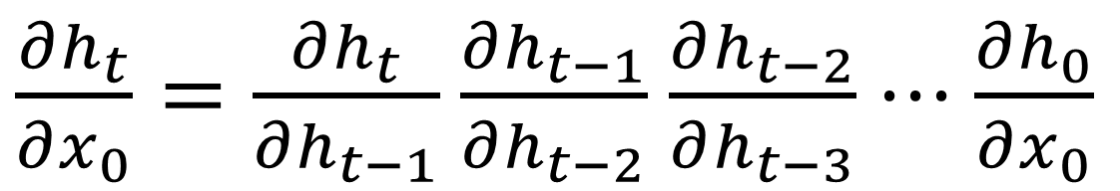
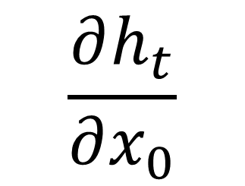
Gradient Vanishing
The dependency between ℎ_𝑡 and 𝑥_0 can be described by
It can be factorized into
$$\frac{∂h_{t}}{∂x_{0}}$$
$\frac{∂h_{t}}{∂x_{0}}=\frac{∂h_{t}}{∂h_{t−1}}$ $\frac{∂h_{t−1}}{∂h_{t−2}}$ $\frac{∂h_{t−2}}{∂h_{t−3}}$ $⋅⋅⋅\frac{∂h_{0}}{∂x_{0}}$
WWW.INTERNSHIPSTUDIO.COM

Slide 7
What’s the results
The partial derivative is close to zero
The output is not related to far pervious inputs
Long dependency is vanishing
WWW.INTERNSHIPSTUDIO.COM

Slide 8
Solutions
Change activation functions
The problem can be alleviated somewhat but not eliminated
May affect the learning performance
LSTM
WWW.INTERNSHIPSTUDIO.COM

Slide 9
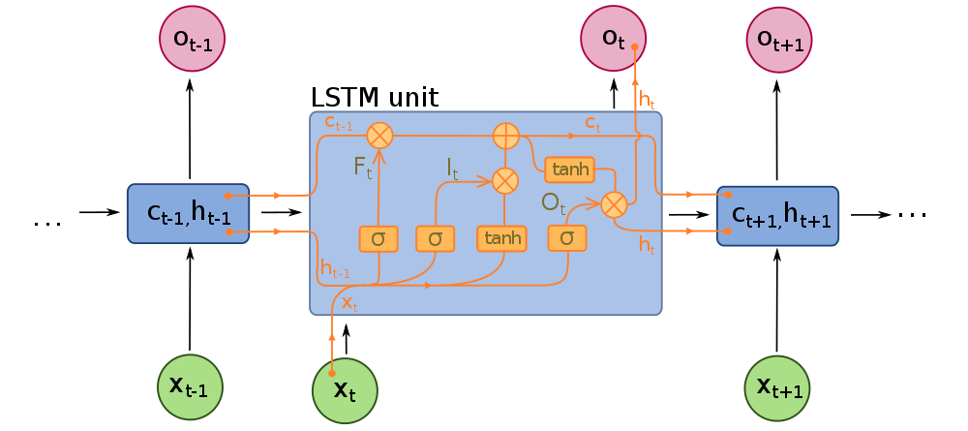
Long Short-Term Memory(LSTM network)
specialized architecture to solve the vanishing gradient problem
an additional “conveyor belt” dataflow to carry information across timesteps
“forget”, “input”, and “output” gates
WWW.INTERNSHIPSTUDIO.COM

Slide 10


RNN/LSTM
WWW.INTERNSHIPSTUDIO.COM

Slide 11
LSTM BreakDown
Hidden states
Input gates
Forget gates
Output gates
WWW.INTERNSHIPSTUDIO.COM

Slide 12
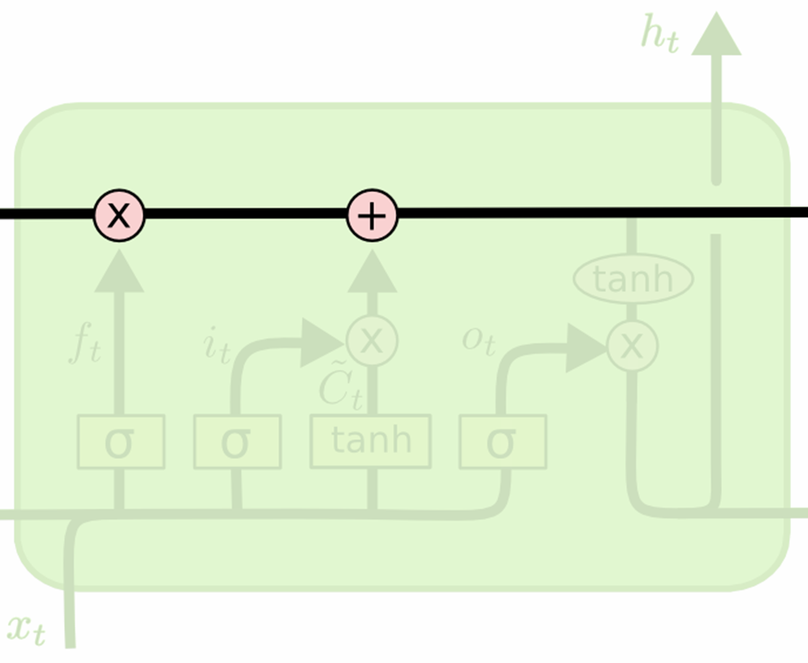
LSTM BreakDown
Hidden states
Carry previous information
Build a direct path
WWW.INTERNSHIPSTUDIO.COM

Slide 13
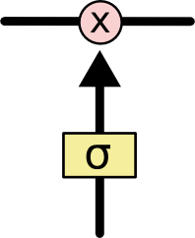
LSTM BreakDown
Gates
A neural network 𝜎
Output range [0, 1]
Pointwise multiplication
Filtering function
WWW.INTERNSHIPSTUDIO.COM

Slide 14

LSTM BreakDown
Forget gates
What is kept from previous states
WWW.INTERNSHIPSTUDIO.COM

Slide 15

LSTM BreakDown
Input gates
What is added to the hidden state
WWW.INTERNSHIPSTUDIO.COM

Slide 16

LSTM BreakDown
Output gates
What is reported as output
WWW.INTERNSHIPSTUDIO.COM

Slide 17
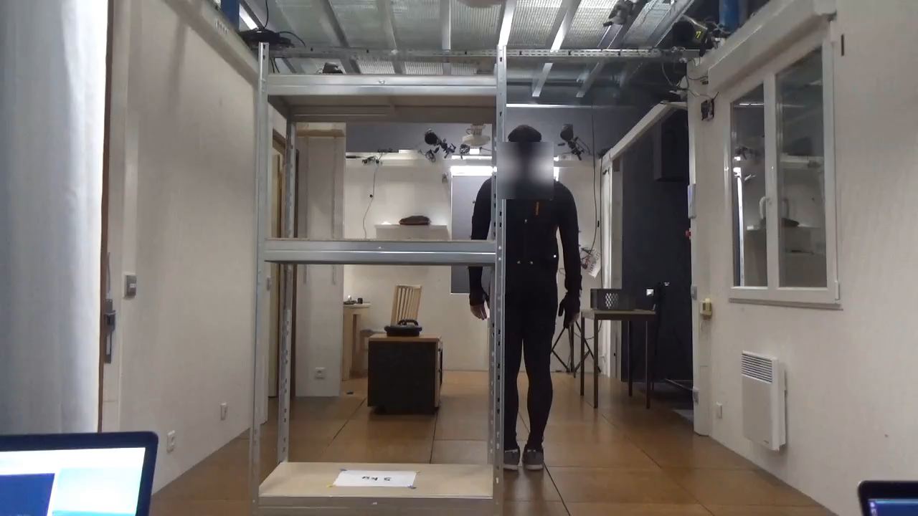
Case Study: Human Action Recognition
8 Action Classes
Reach (1)
Pick (2)
Place (3)
Release (4)
Carry (5)
Fine Manipulation (6)
Screw (7)
Idle (8)
Dataset is recorded with Xsens Sensor that has 23 marker position. Dataset is record at 240 FPS
WWW.INTERNSHIPSTUDIO.COM

